Slide 1
ICANN
Webinar
17 February 2025

Slide 2
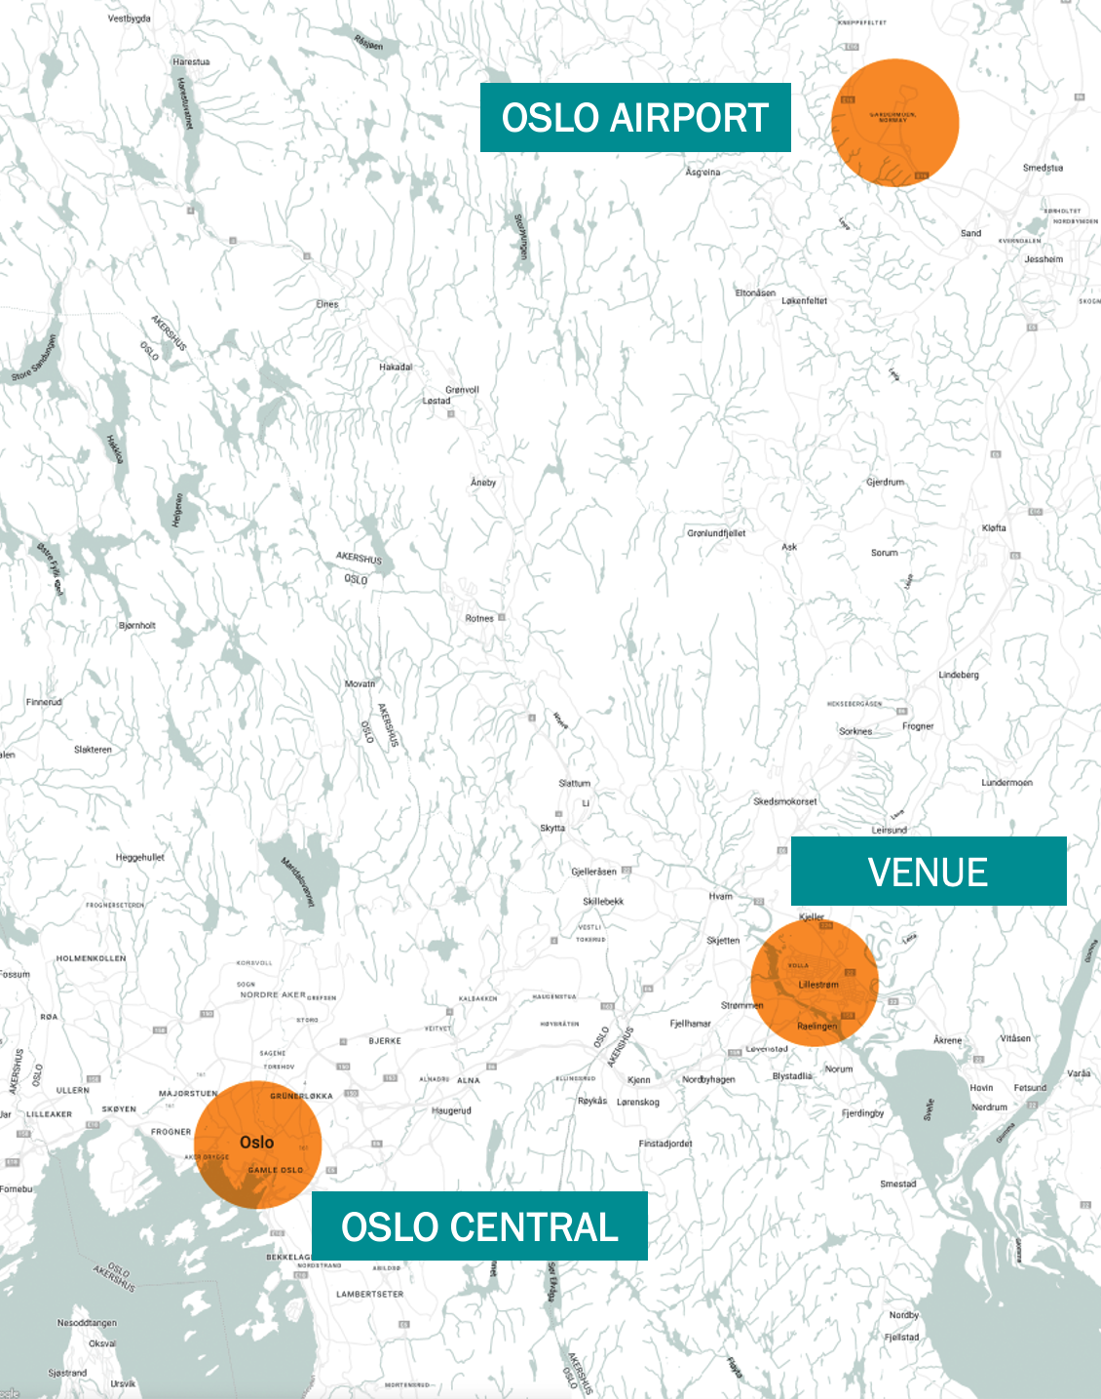
Oslo and Lillestrøm
OSLO AIRPORT
LILLESTRØM ST.
NOVA SPEKTRUM
THON HOTEL AREMA
OSLO CENTRAL
12min
10min
19min
42min
23min
29min

Slide 3
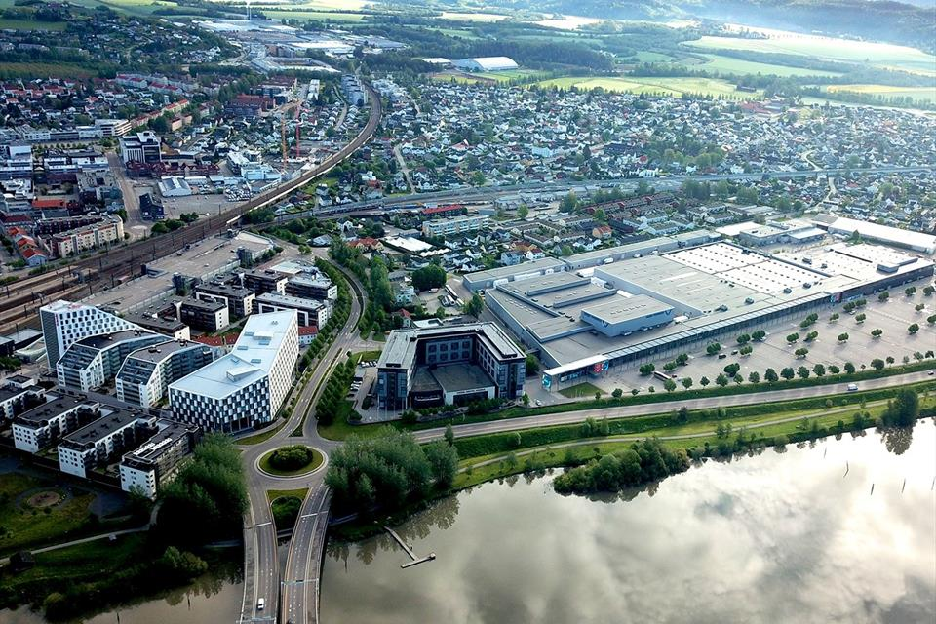
Railway station

Slide 4
www.igf2025.no

Slide 5
www.igf2025.no

Slide 6
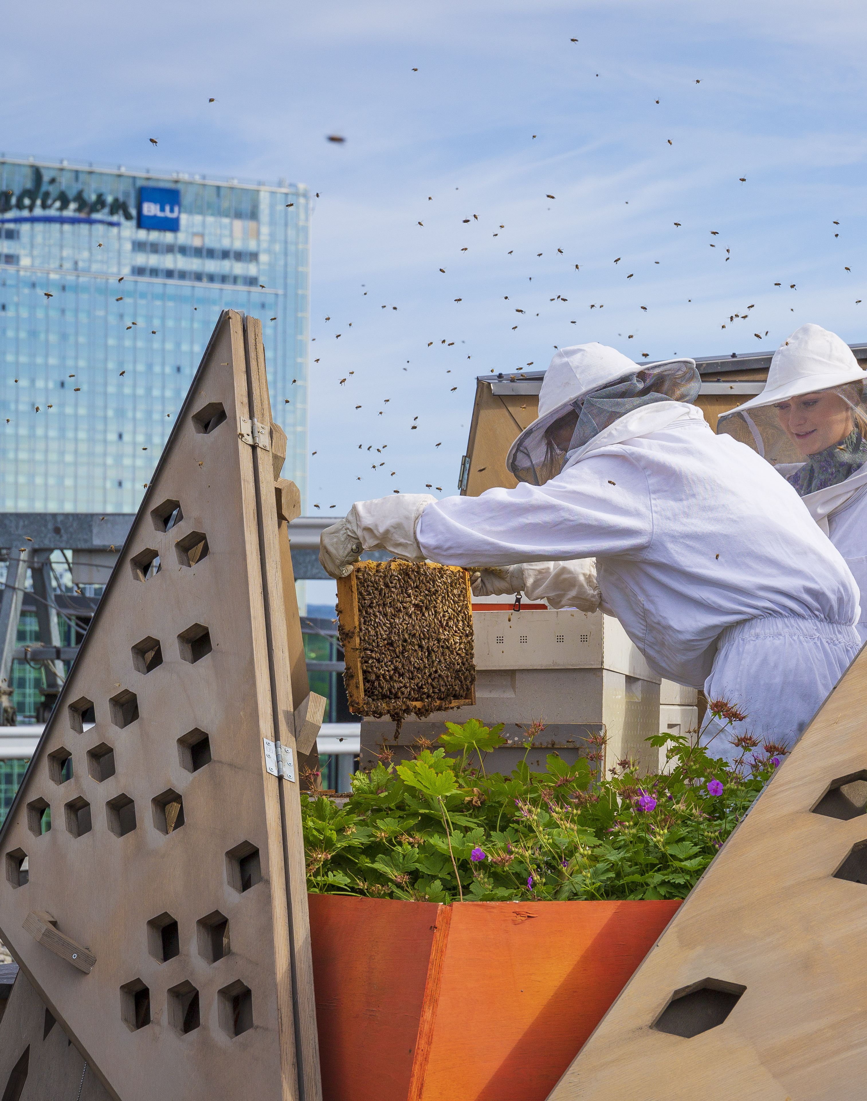
Accommodation
Multiple hotel groups known for their solid sustainability policies are well-represented in Oslo.
In total, 95% of Oslo’s hotels are eco-labelled or certified.
Participants at IGF Norway 2025 are offered discounted rates at several hotels in Oslo through the host country website.
Wide range of accommodation, from budget-friendly to high-end hotels.
‍Room reservations are subject to availability, and current rates are valid until 25 March.
www.igf2025.no

Slide 7
Roadmap
12 Feb: Call for Session Proposals
20 Feb: Launch IGF 2025 Registration
March-April: Session Evalution
May: Bilateral Meeting Request System
April: Draft IGF 2025 Schedule and Village Plan
April: Second Open Consultation
23-27 June: IGF 20th Annual Meeting

Slide 8
Building Digital Governance Together
1. [Building] Digital Trust and Resilience
GDC 3, 4, 5 - WSIS C5, C9, C10 - SDGs 9, 16, 12, 17; Cybersecurity and Trust, Data Governance, Artificial intelligence, Media and Content, Rights and Freedoms [Capacity Building]
2. [Building] Sustainable and Responsible Innovation
GDC 1, 2, 4, 5 - WSIS C1, C6, C7, C10, C11 - SDG 7, 8, 9, 13, 14, 15, 16, 17; Environmental Sustainability and Climate Change, Economic Issues and Development, Emerging Technologies and Innovation, Artificial intelligence, Technical and Operational Topics
3. [Building] Universal Access and Digital Rights
GDC 1, 2, 3, 4 - WSIS C2, C3, C4, C7, C8, C10 - SDG 1, 2, 3, 4, 5, 8, 10, 11, 16; Rights and Freedoms, Universal Access and Meaningful Connectivity, Economic Issues and Development
4. [Building] Digital Cooperation
GDC 3, 4, 5 - WSIS C1, C2, C3, C4, C6, C10, C11 - SDG 9, 10, 11, 16; Digital Cooperation, Emerging technologies and Innovation, Artificial intelligence, Sustainable Multistakeholder Governance

